Slide 1
Are there differences in pupil response to a light stimulus between Marijuana daily, occasional and non-Users?
Suni Godbole

Slide 2
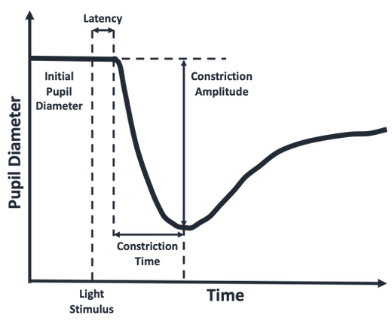
Background
Pupil size reflex to a light test is a potential test to determine if a person is under the influence of THC
Can it be used a field sobriety measure?
Pupil light reflex
Unlike other behaviors that may be used for field sobriety measure, the pupil light reflex does not exhibit a susceptibility to tolerance.
https://www.sobereye.com/plr-references

Slide 3
Data
Participants self-identified as daily, occasional or non-user of marijuana
They participated in a variety of field sobriety measures, including a driving simulator and pupil light reflex test before and after consuming a marijuana (if they were daily or occasional users)
Non-user just spent similar time between tests in a quiet room (dark?)
84 individuals with pre- and post-consumption light reflex measures
Light reflex test
The light exposure time was variable between participants but unrelated to marijuana user category
Participants are fitted with goggles that allowed for a video recording of the eyes during the test
Individual images were processed with image analysis techniques to isolate the pupil and estimate it’s size.
The trajectory of the pupil size was used to define a start time for the light stimulus
Percent change was calculated from the start of the light stimulus
Ben’s Work

Slide 4
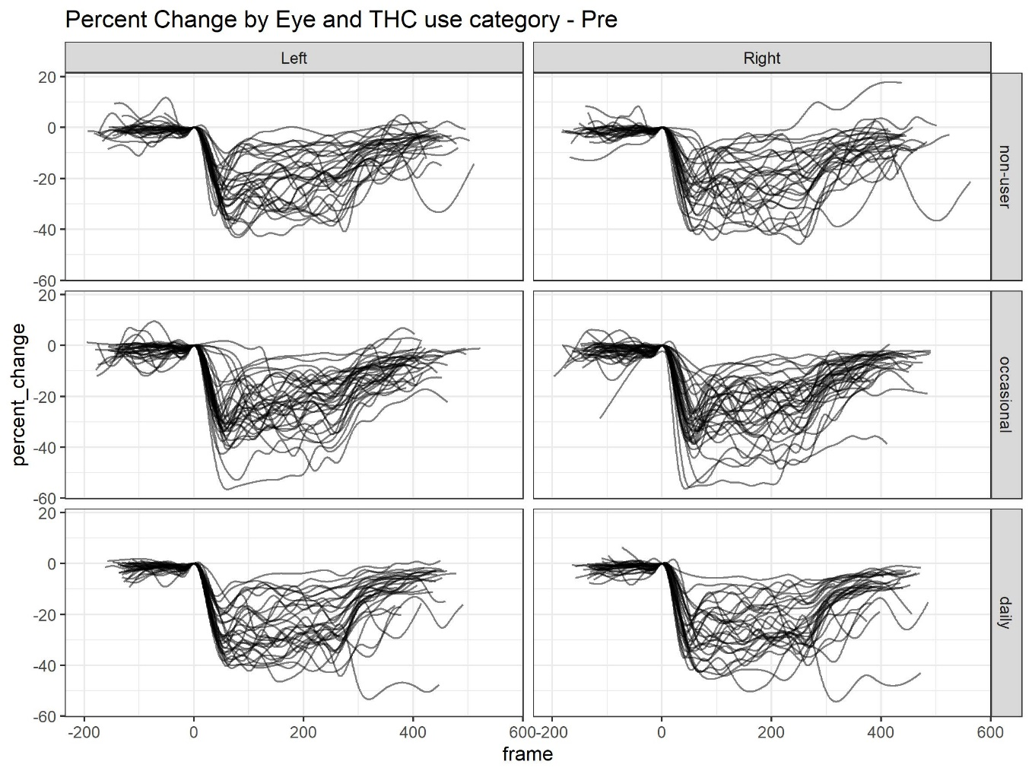
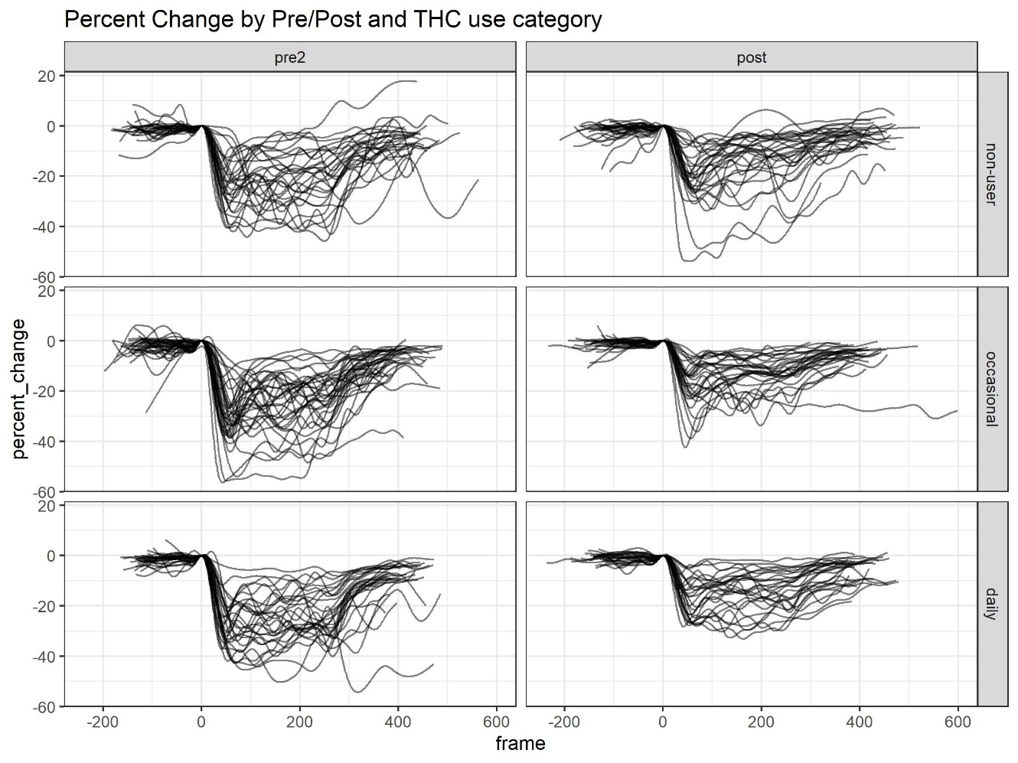
Pupil Response Trajectories

Slide 5
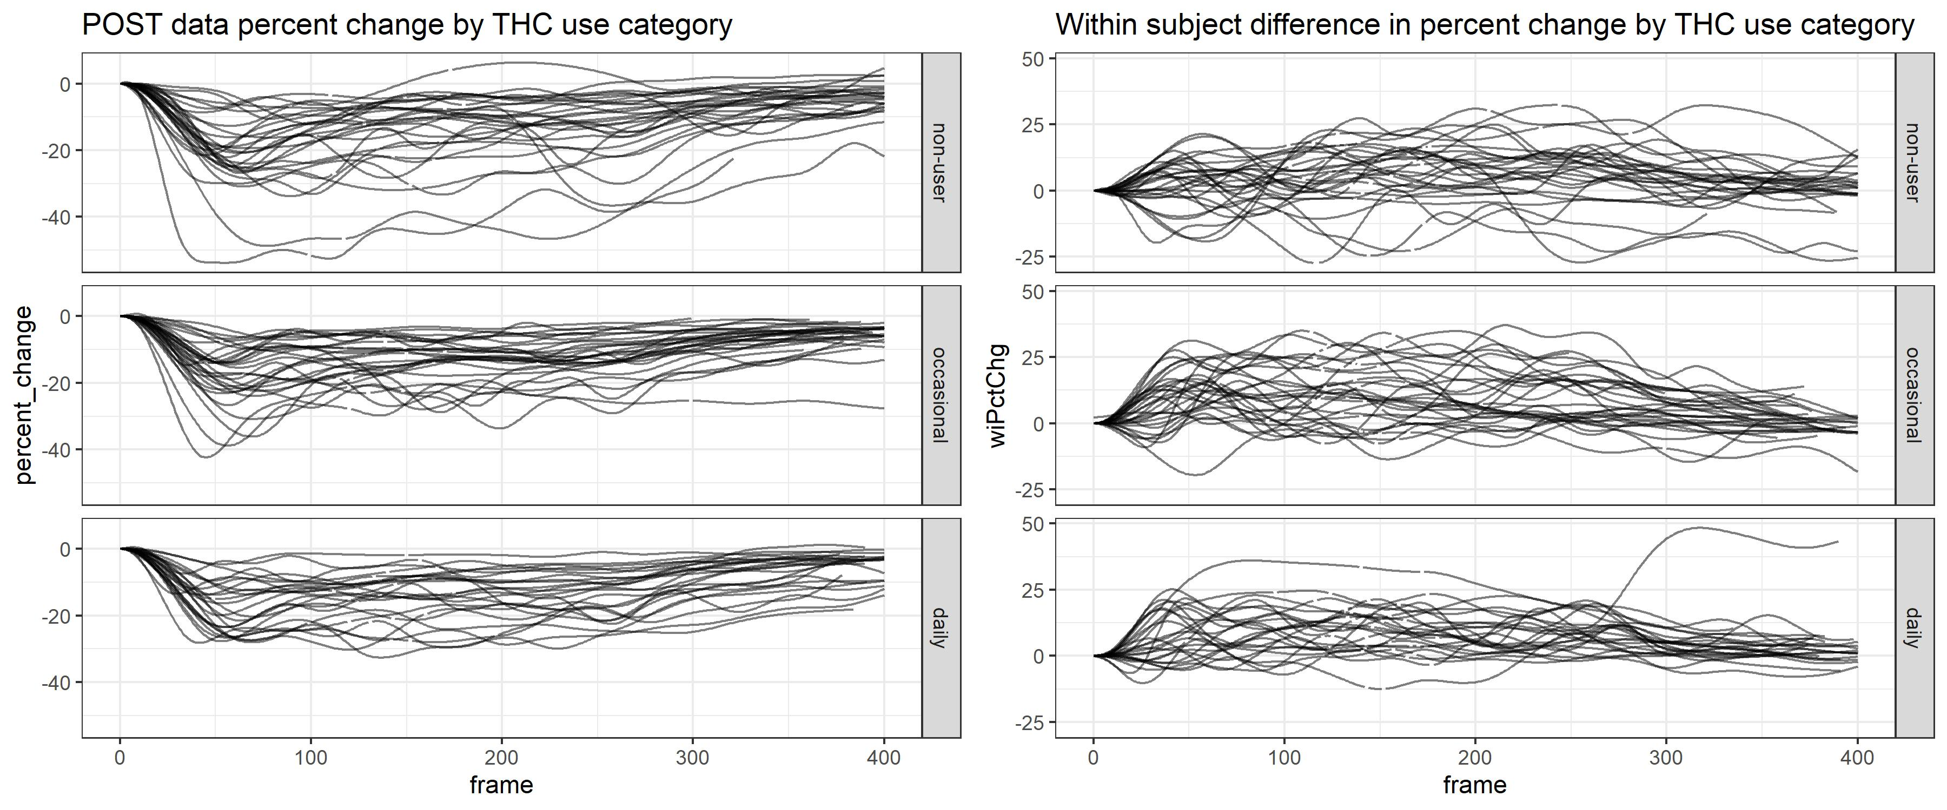
Post & Within Person Difference (WPD) Trajectories

Slide 6
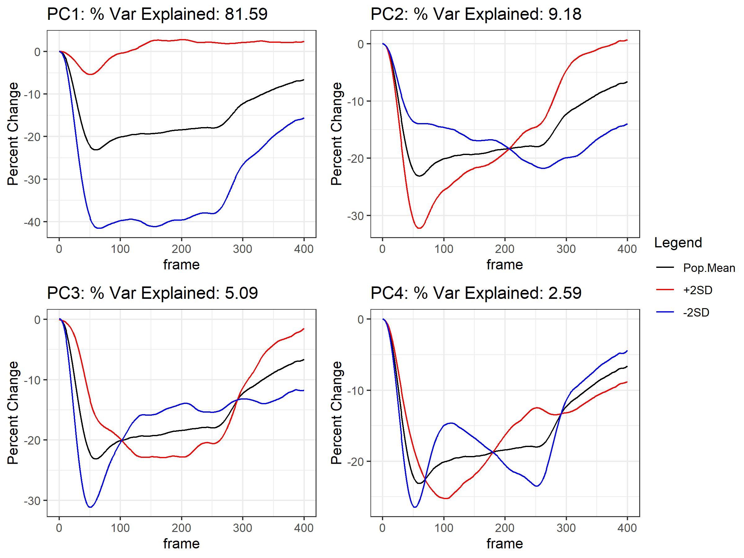
fPCA – post
PC 1 – focuses on minimal constriction
PC 2 – differences in overall shape of the trajectory

Slide 7
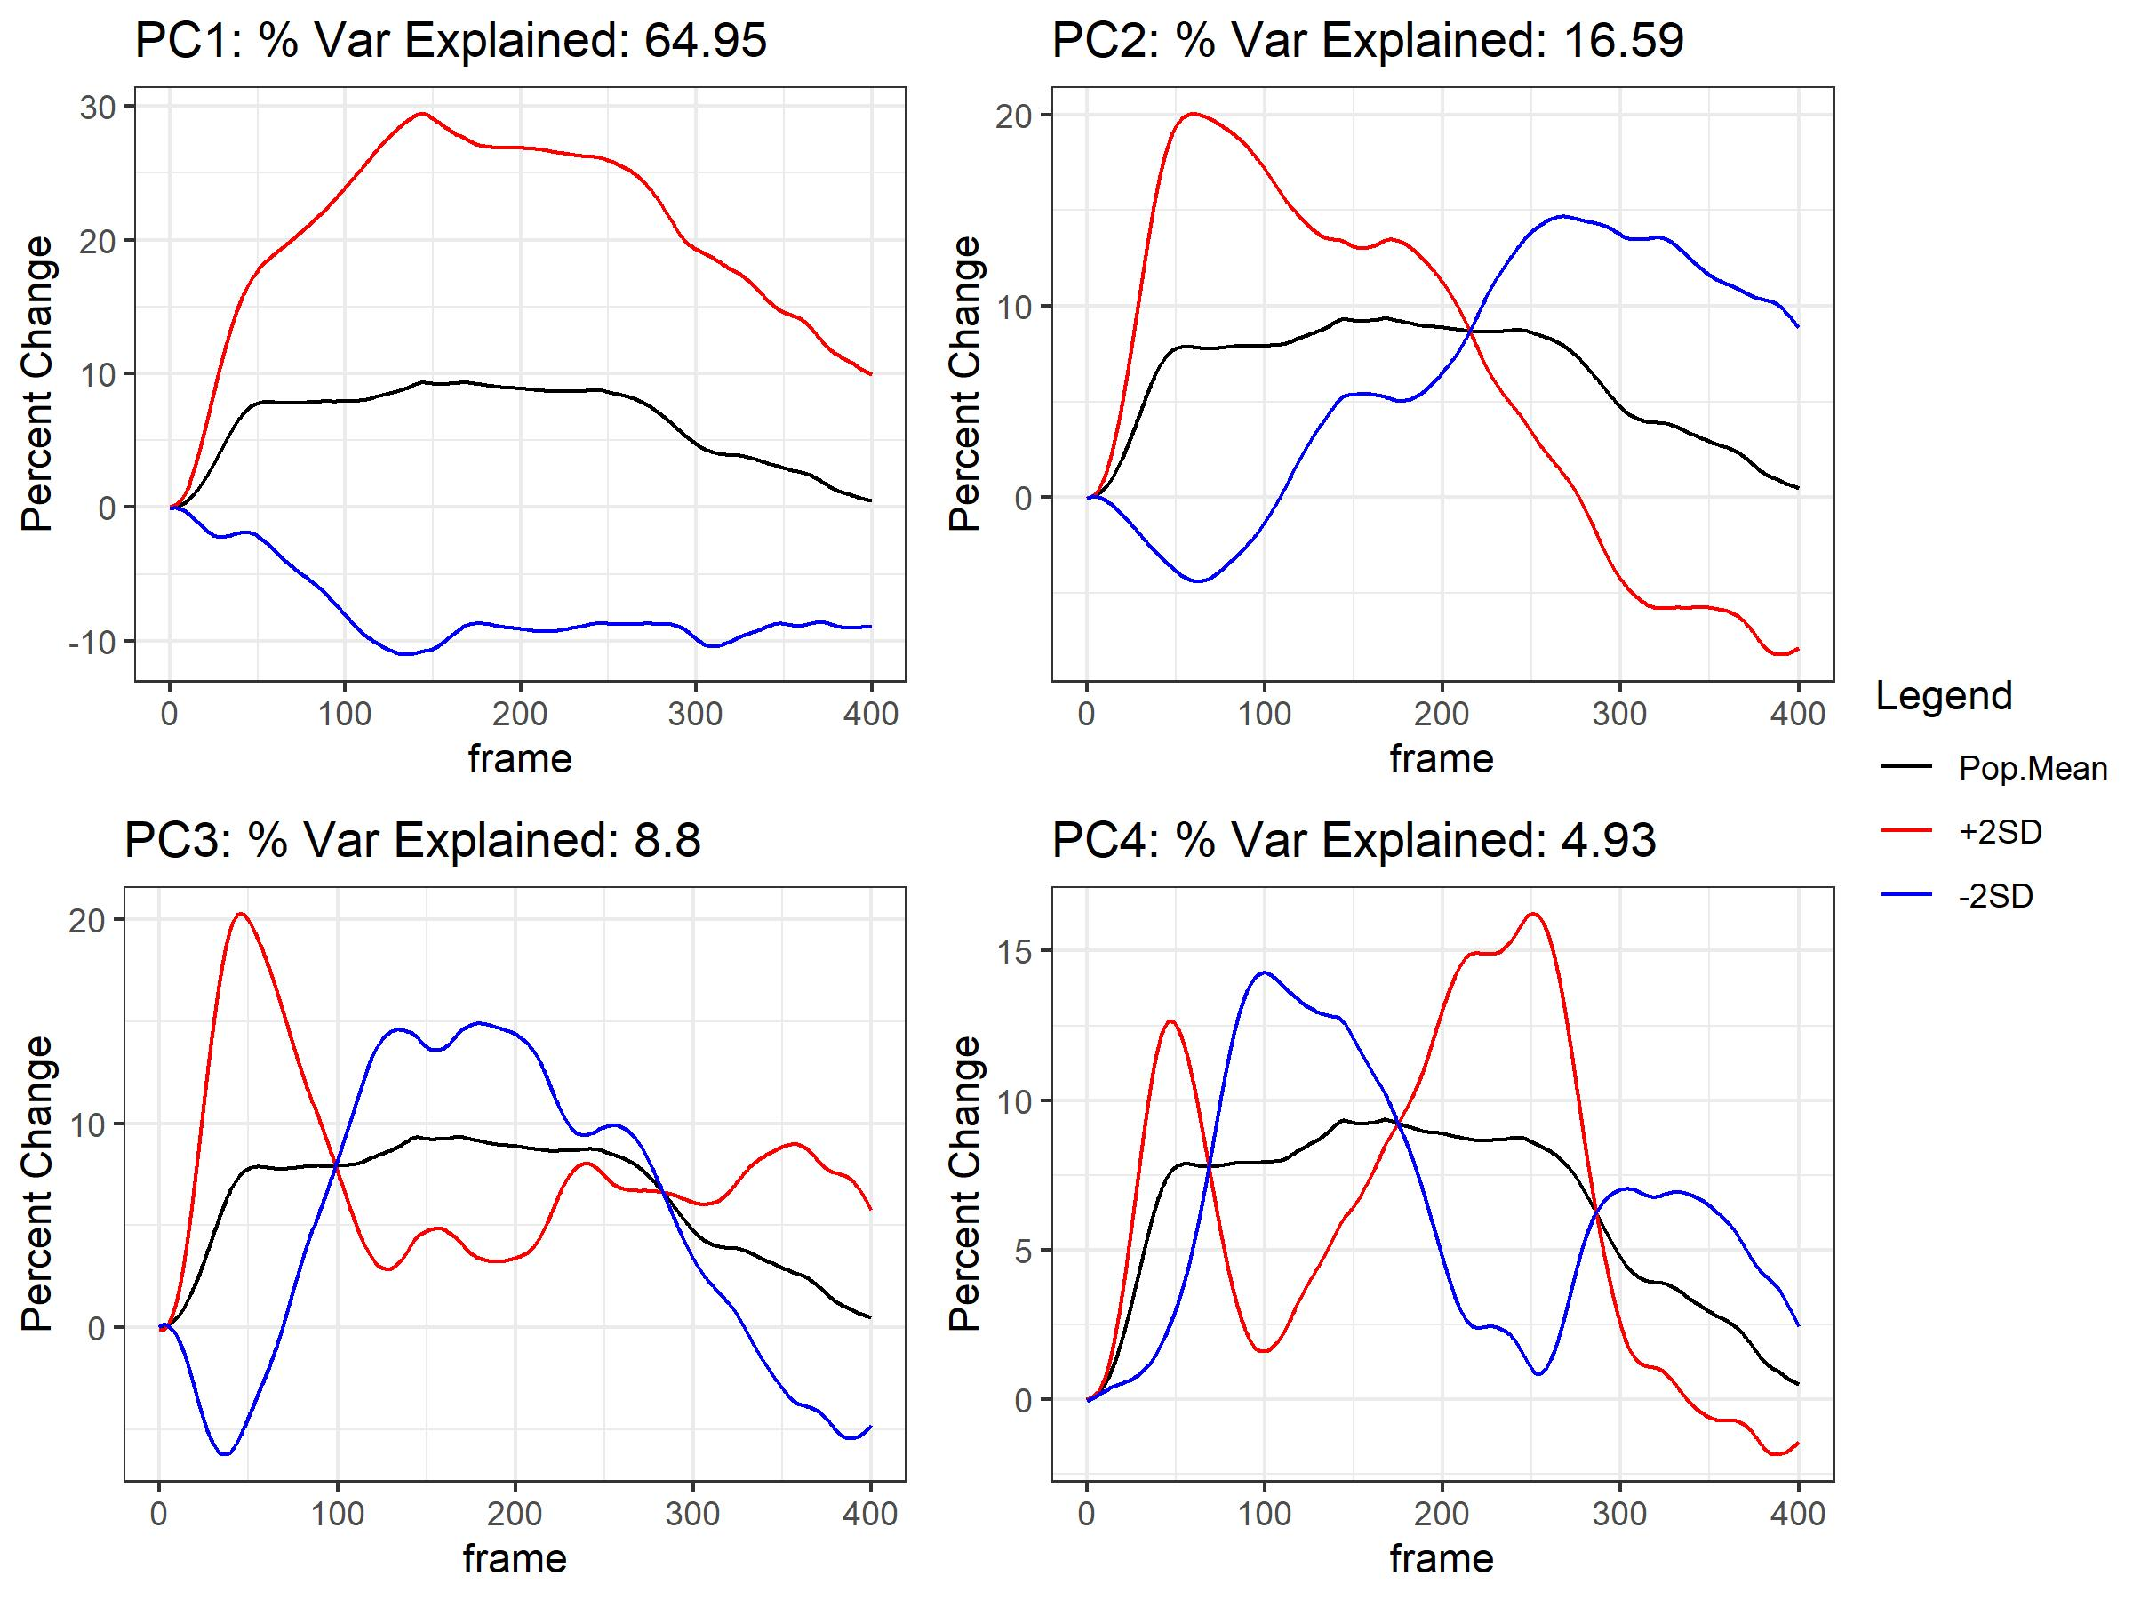
fPCA - WPD
PC 1: Difference in minimal constriction
PC 2: Overall shape, difference in minimal constriction and recovery

Slide 8
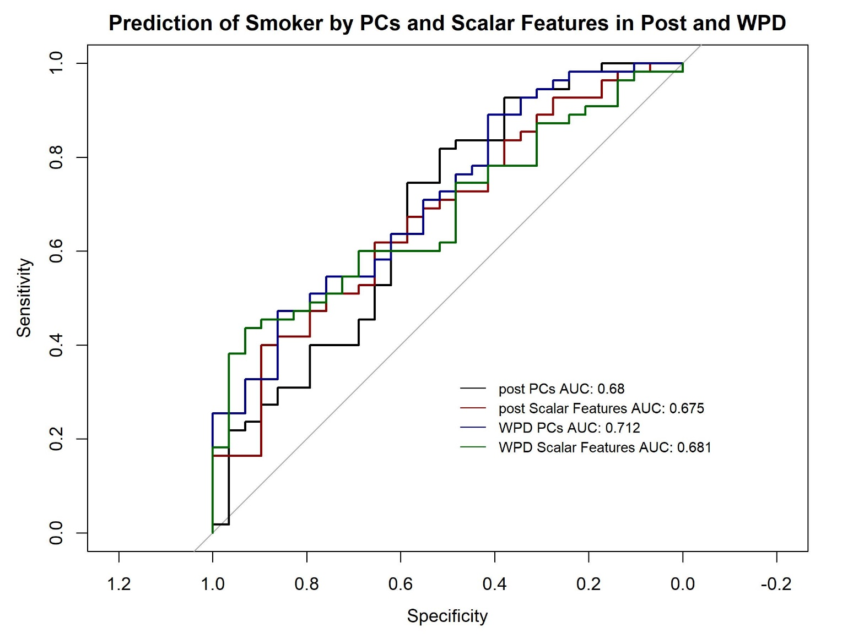
Prediction of Smoker vs Non-smoker
Logistic Regression model regressing smoking status on 4 PCs or Scalar Features
Separate models for post and WPD values
Scalar Features (post or change):
Minimal Constriction
AUC
Slope

Slide 9
PCs Association with Demog Variables
Demographic Variables
Age, Sex, Weight, Height, BMI, Change in THC, Time from consumption to Post test
Linear regression models (except for Sex – logistic)
Results
Post: BMI negatively associated with PC2 after adjust for other PCs (p = 0.03)
WPD
Weight negatively associated with PC 2 (p = 0.04) & positively associated with PC5 (p = 0.009)
Height positively associated with PC5 (p = 0.006)
BMI positively associated with PC1 (p=0.049)
Male positively associated with PC5 (p=0.040)

Slide 10
Function on Scalar Regression
(FoSR)

Slide 11
Model

Slide 12
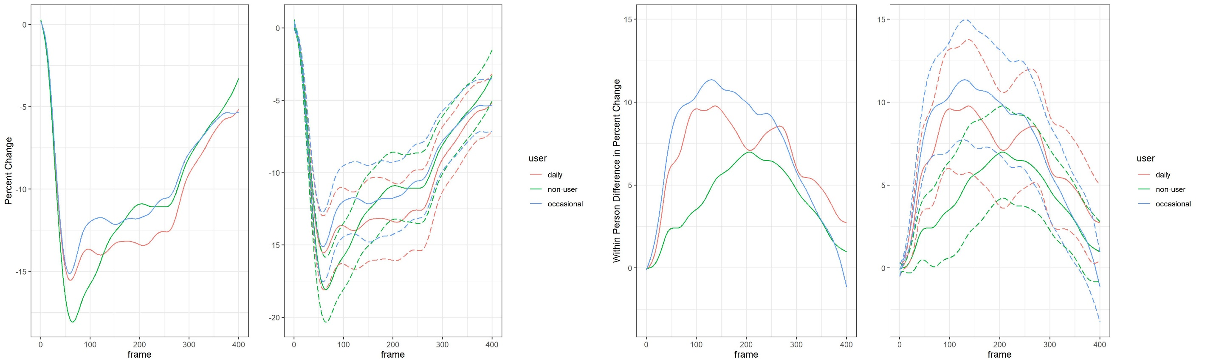
Mean Trajectories for Post & WPD
Post
WPD

Slide 13
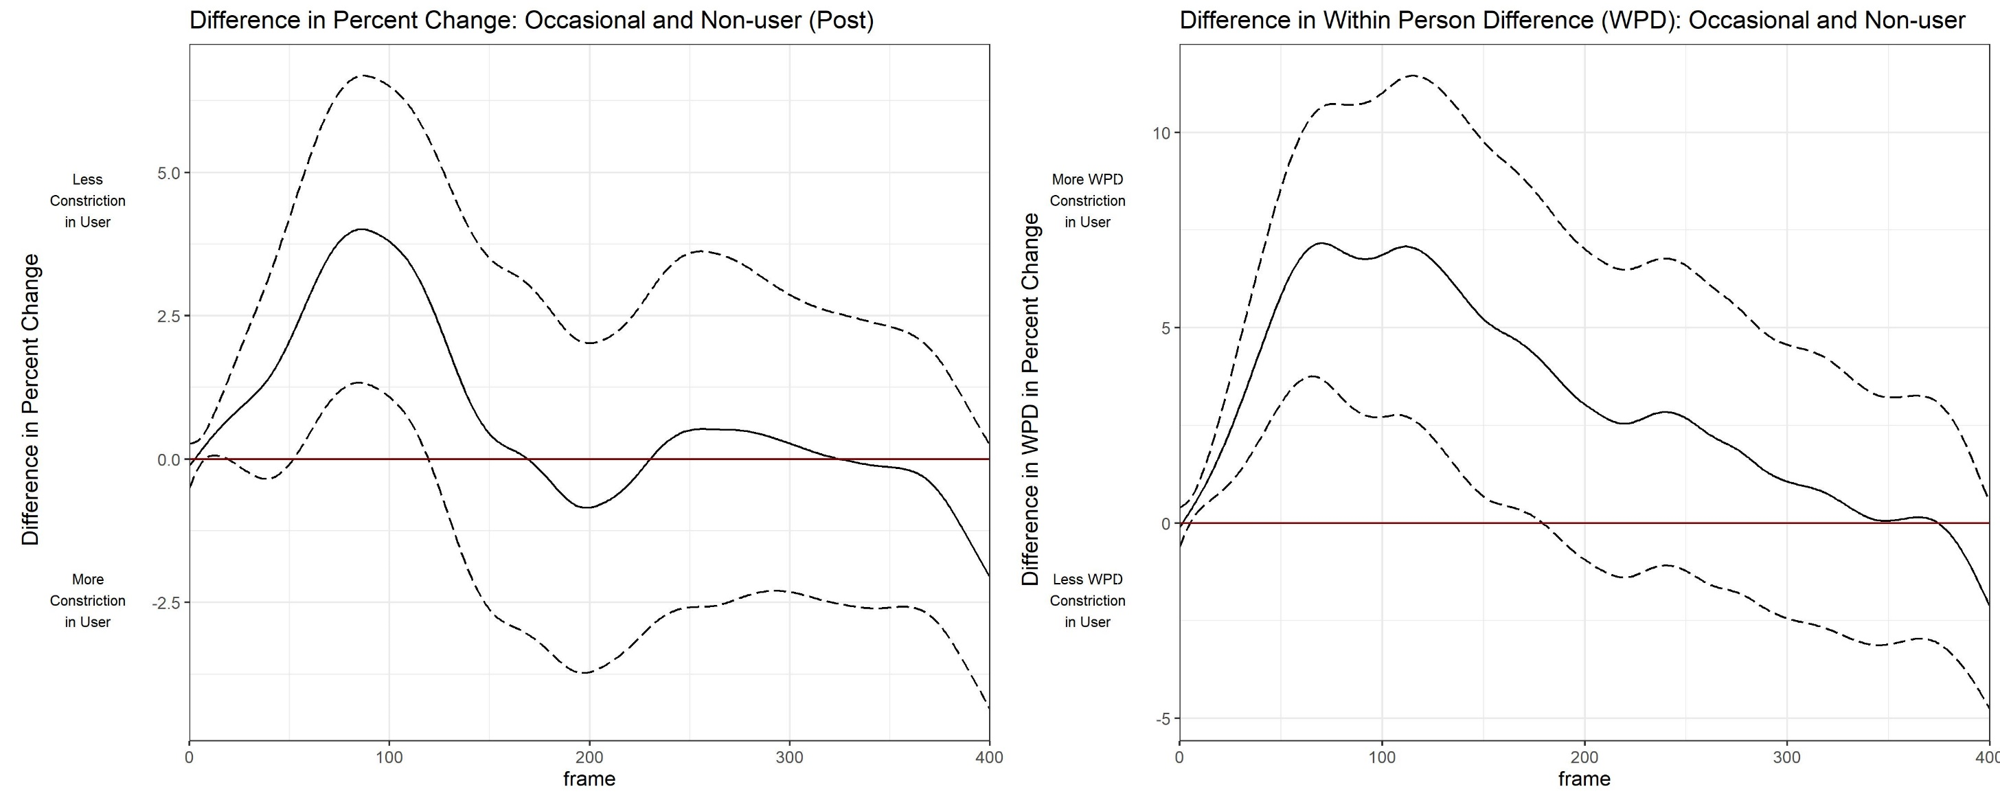
Differences btw Occasional & Non-Users

Slide 14
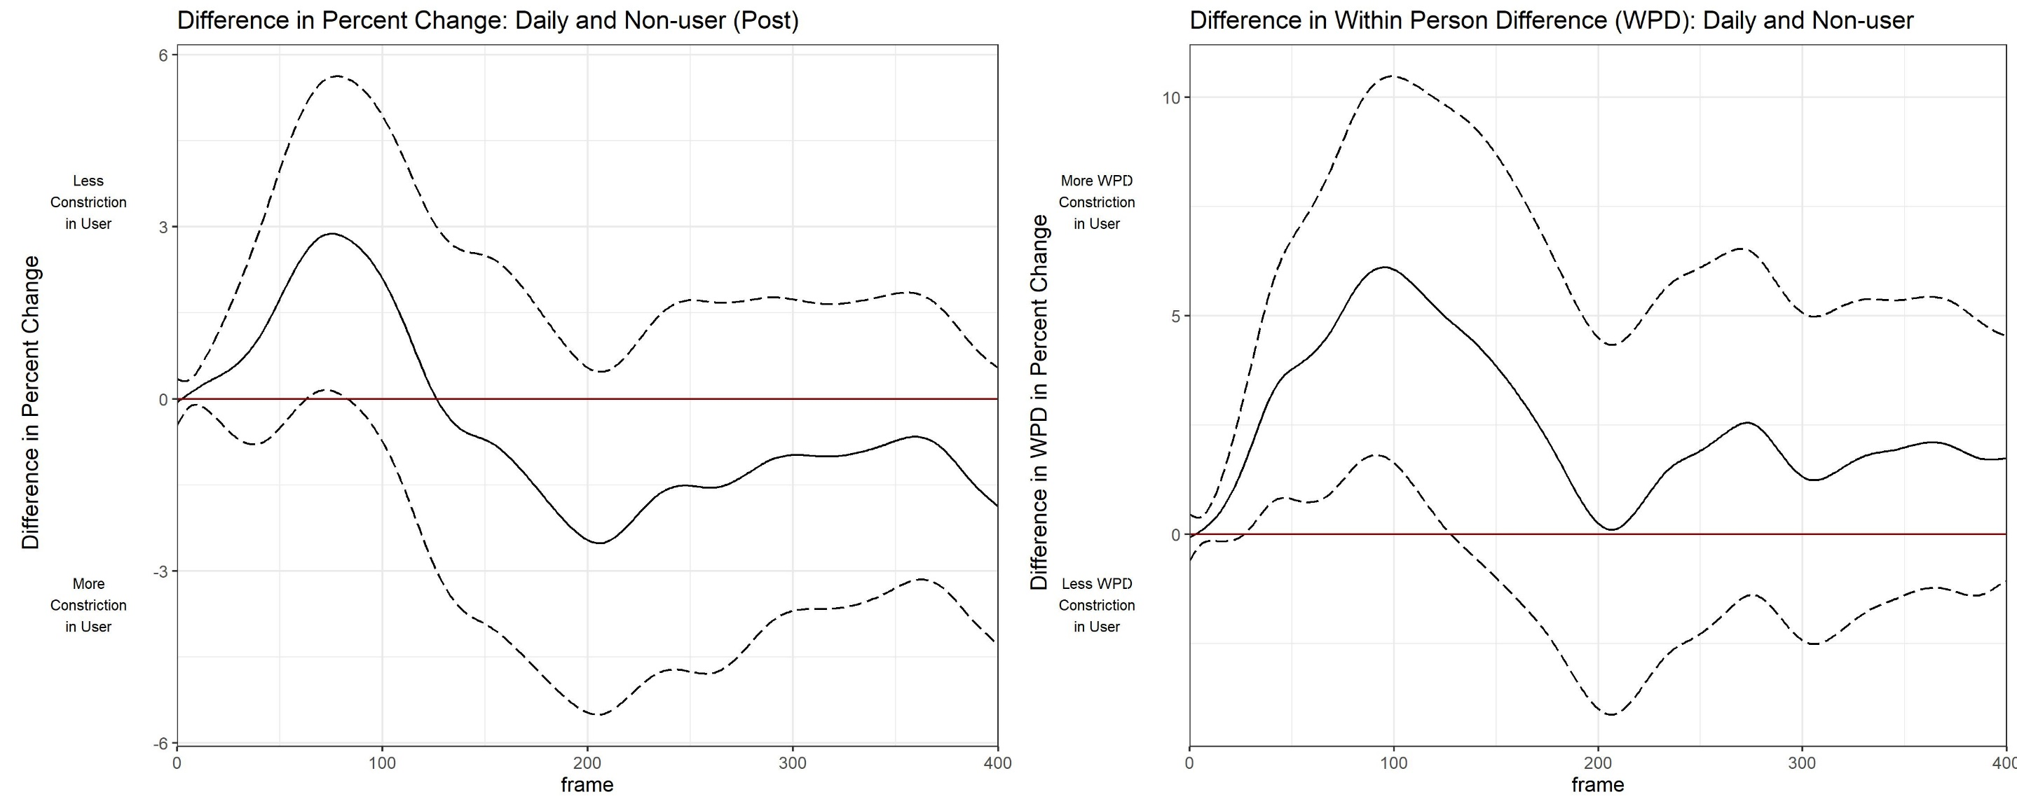
Differences btw Daily & Non-Users

Slide 15
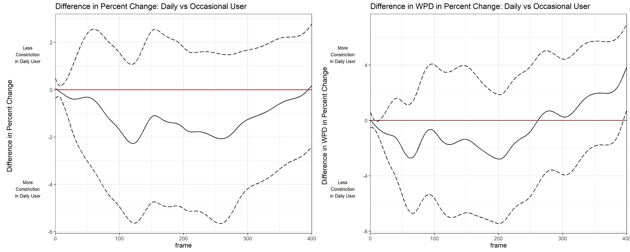
Differences btw Daily & Occasional

Slide 16
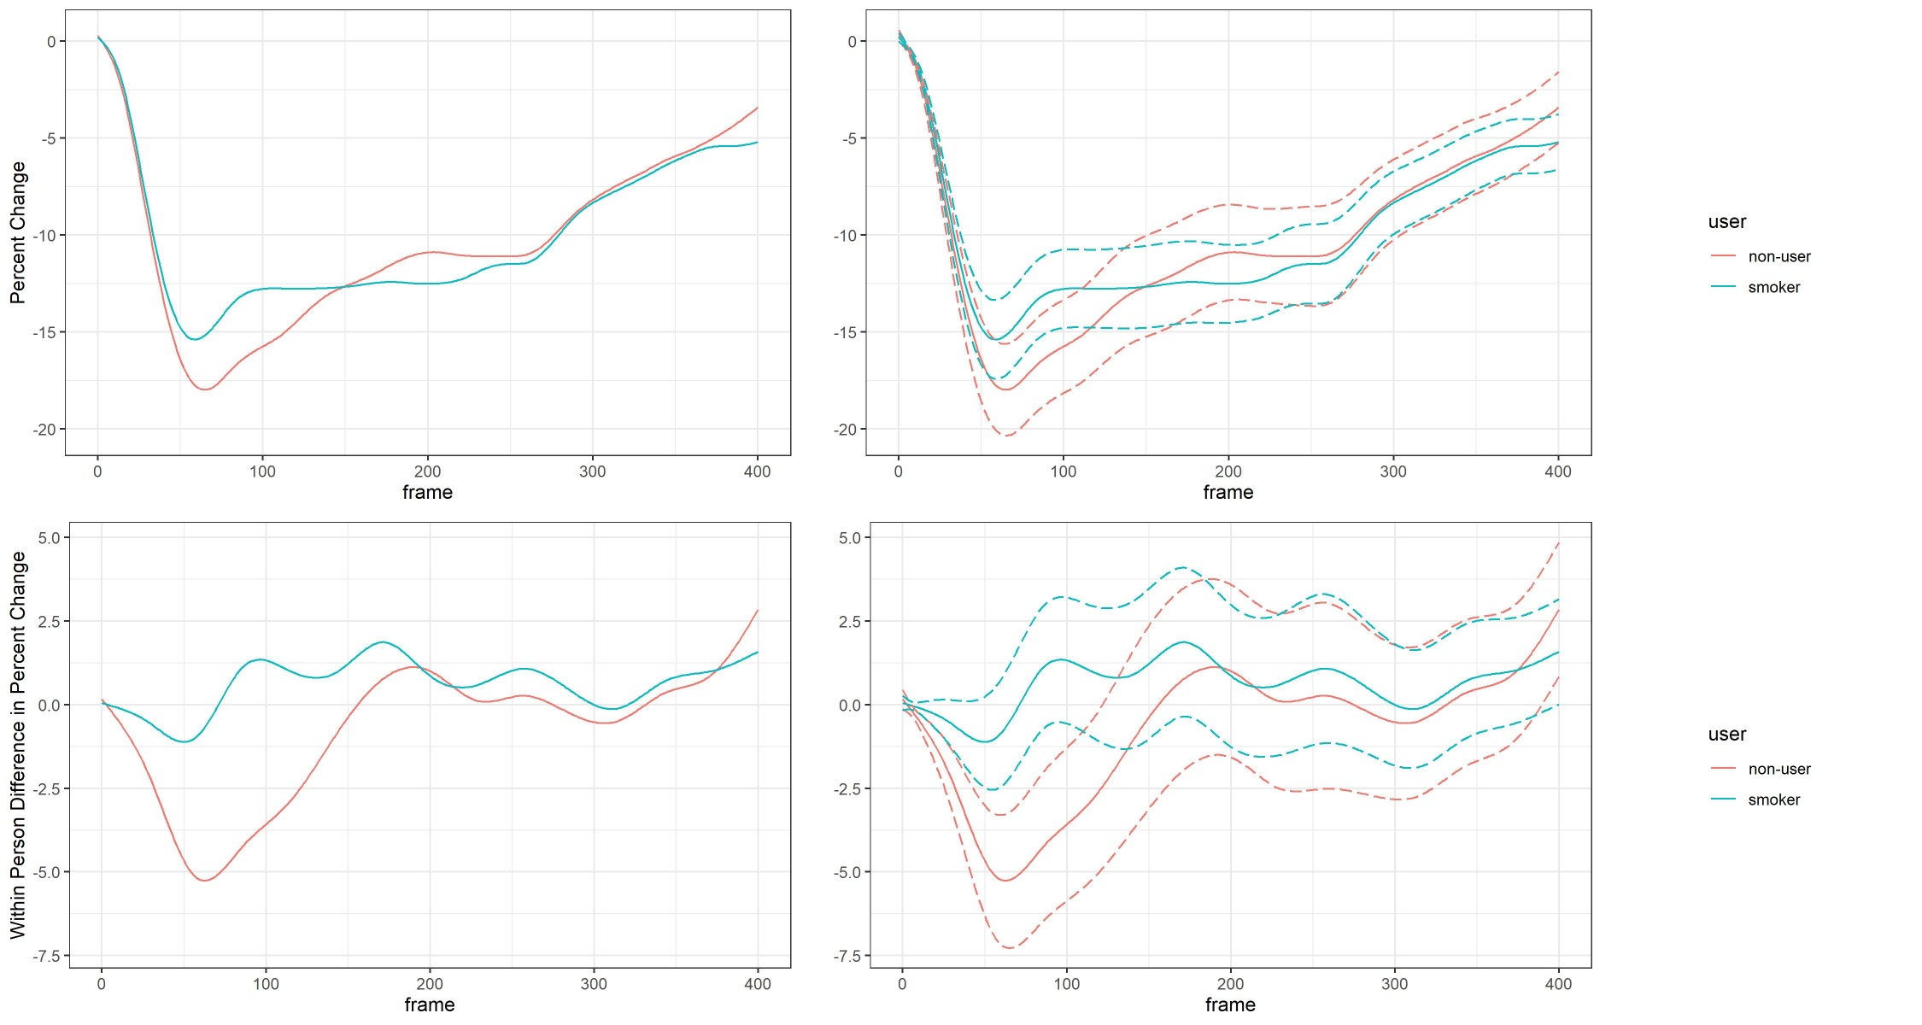
Mean Trajectories of Smokers & Non-Smokers
Post
WPD

Slide 17
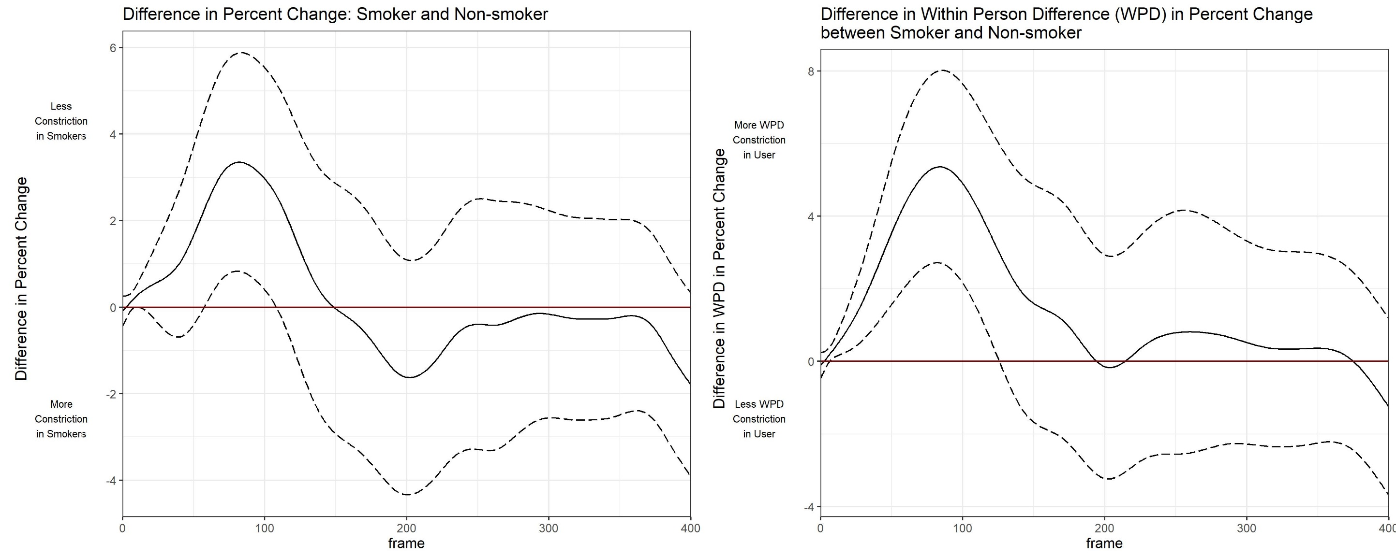
Differences btw Smoker & Non-Smoker

Slide 18
Conclusions
Small, significant, difference between occasional and non-users for both post and WPD data – differences in minimal constriction
Smaller differences between daily and non-users
Small, significant, difference between smokers and non-smokers for both post and WPD data

Slide 19
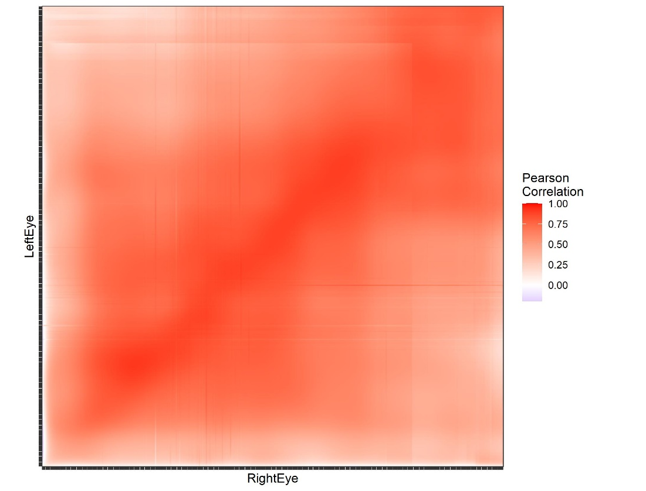
Next Steps
Investigating time from consumption to post-test
Correlations between eyes

